Slide 1

Introduction

Slide 2
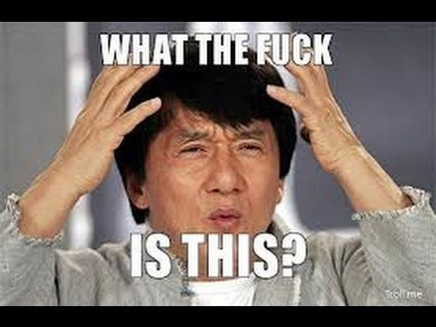
Introduction to Programming
What is Computer Programming?
“Computer programming is the process of designing and building an executable computer program for accomplishing a specific computing task. Programming involves tasks such as analysis, generating algorithms, profiling algorithms' accuracy and resource consumption, and the implementation of algorithms in a chosen programming language (commonly referred to as coding)”
wikipedia.org

Slide 3

Introduction to Programming
In Simple words
“programming is telling a computer what to do in it’s own language”

Slide 4
What to expect from this tutorial?
Who is it for?
For absolute beginners to computer programming
For those who are interested in learning python
Learning Outcomes:
Basic idea of a programming language
Approaching a problem from computer’s perspective
Prepare you for working on real life projects
Exercises to practice what you actually learned

Slide 5
Introduction to Programming
Common Misconceptions about Programming
I Have To Master Mathematics To Learn a Programming Language
I Must Be A Genius (With An IQ OF 160)
I Have To Go To University To Learn To Code
I Should Memorize All Syntaxes And Avoid Help
I Can Only Start Making Money Once I have Mastered Programming

Slide 6
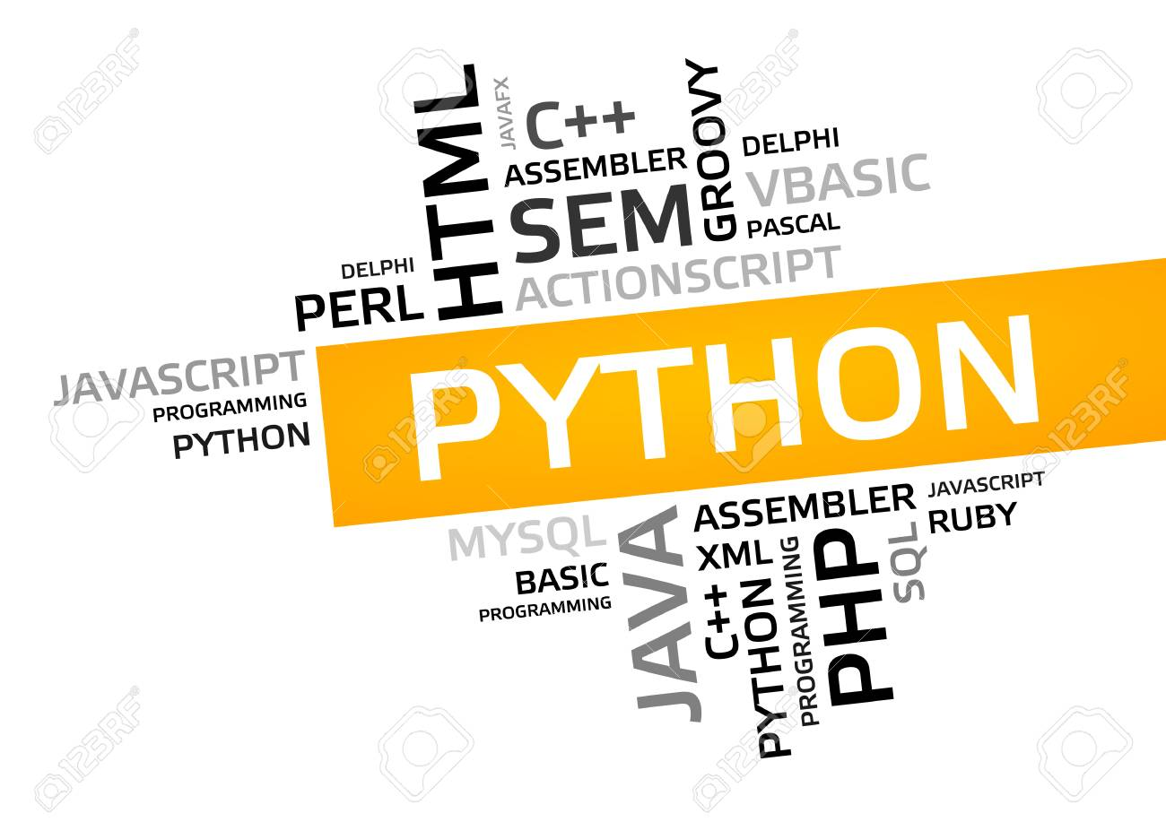
Introduction to Programming
Different Programming languages out there:

Slide 7
Introduction to Python
Introduction
Is Scripting language
Scripting vs Compiled languages
Dynamic Language
Easy to learn
General purpose language
Very intuitive & English like syntax

Slide 8

Introduction to Python
Applications
Building websites (Django, Flask etc)
Artificial Intelligence (tensorflow, keras etc)
Microcontrollers programming (MicroPython, CircuitPython etc)
Scientific programming (Numpy, Matplotlib, pandas etc)
and many more...

Slide 9
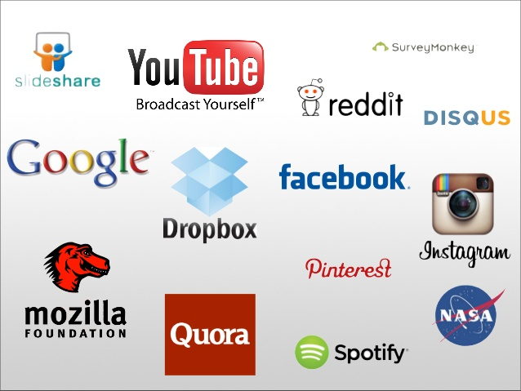
Introduction to Python
Who uses Python
And many more...

Slide 10
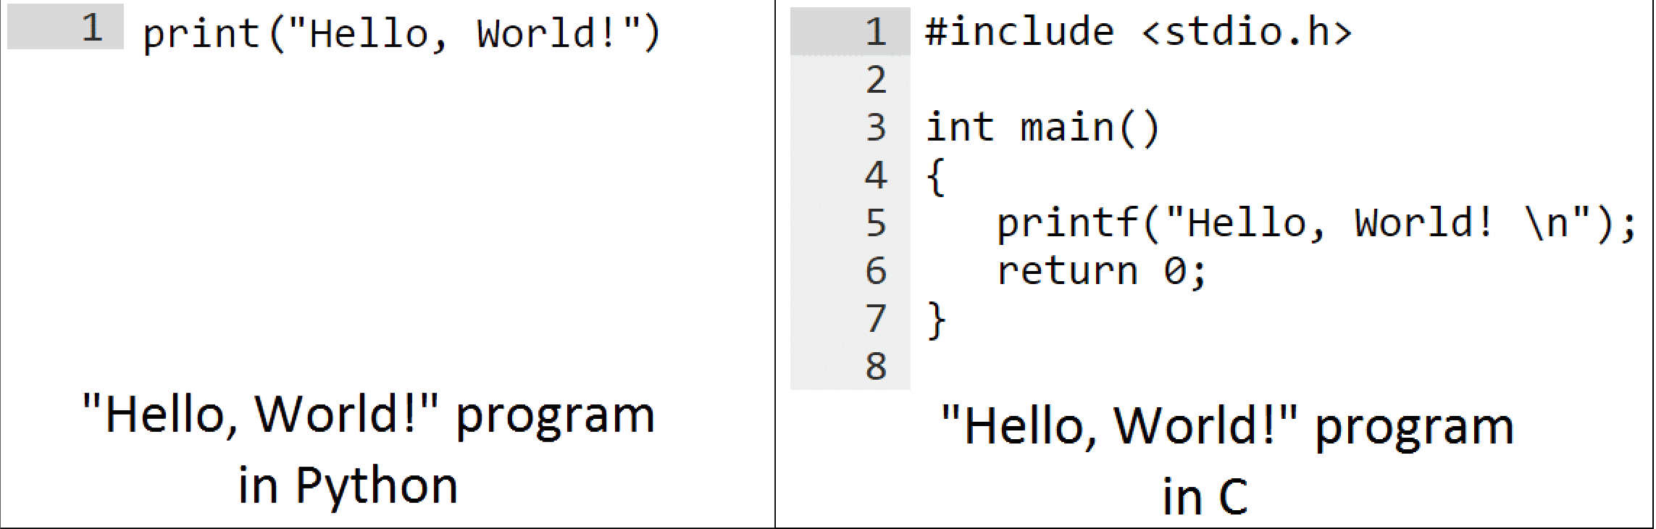
Introduction to Python
Code

Slide 11
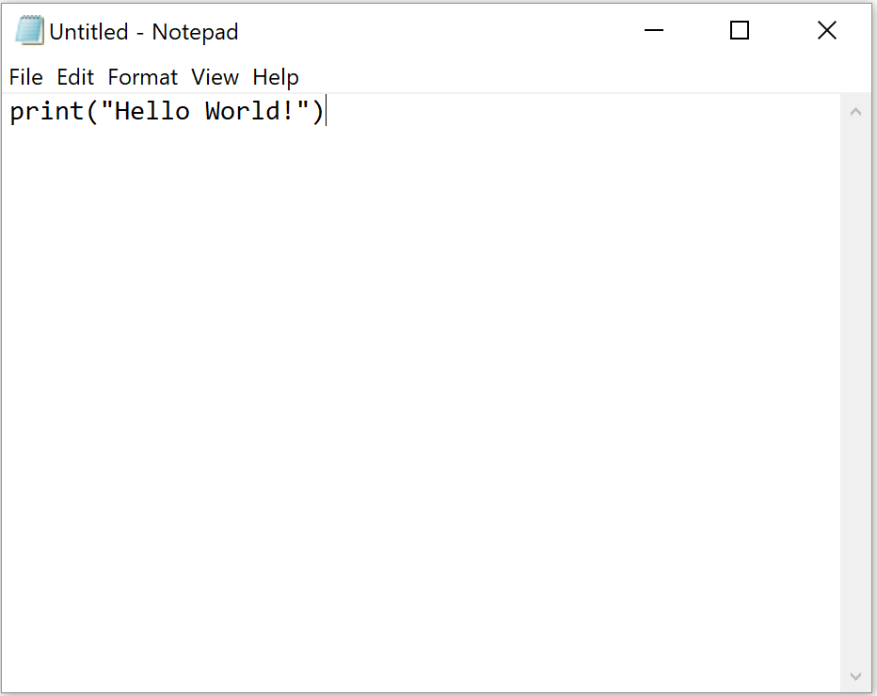
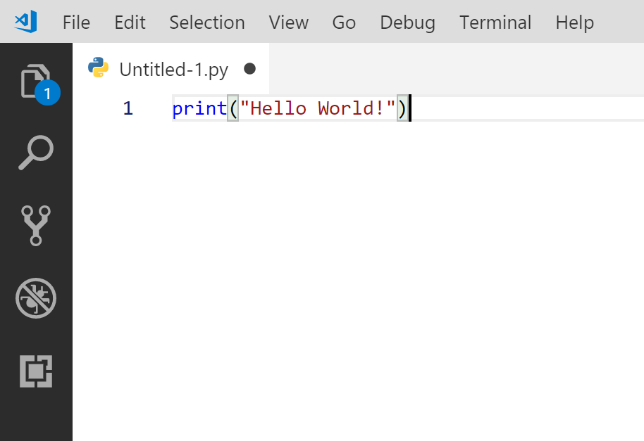
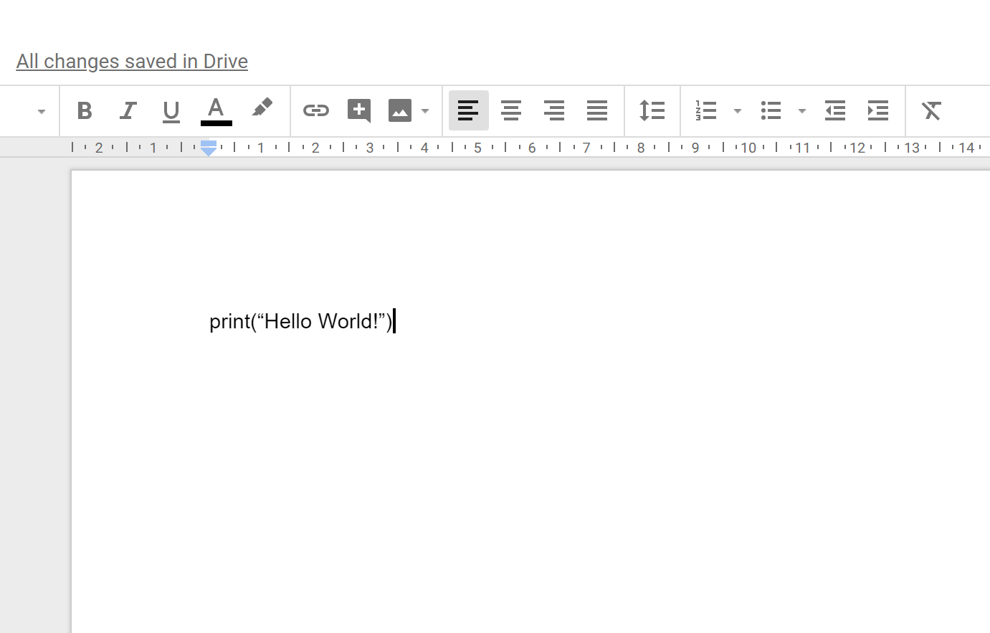


Introduction to Python
Where can you write Code
Text Editor
Code Editor
Rich text editor
e.g Ms Office

Slide 12
Objectives
To read python code
Write command line applications in python
Can solve basic problems using python (i.e prime factorization etc)
Use third party modules and packages
There are over 130,000 modules available for you to use

Slide 13
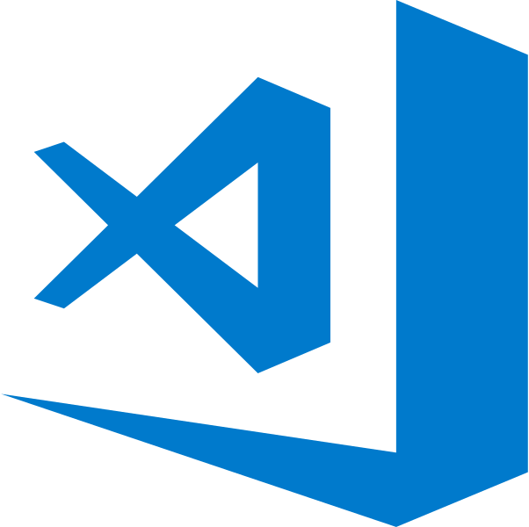
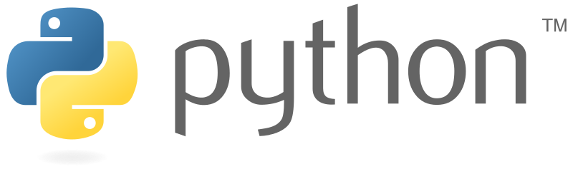
Tools & Technologies
Visual Studio Code
code.visualstudio.com
Python 3
www.python.org/downloads

Slide 14
SETUP
Install Python 3 (www.python.org/downloads)
Install VS Code (code.visualstudio.com)
Start off with the “Hello World” script

Slide 15
References
https://www.python.org/
https://micropython.org/
https://www.tiobe.com/tiobe-index/

